Slide 1
Programming Language II CSE-215
Prof. Dr. Mohammad Abu Yousuf
yousuf@juniv.edu

Slide 2
Inheritance and Method overriding

Slide 3
Inheritance in Java
Inheritance in java is a mechanism in which one object acquires all the properties and behaviors of parent object.
The idea behind inheritance in java is that you can create new classes that are built upon existing classes. When you inherit from an existing class, you can reuse methods and fields of parent class, and you can add new methods and fields also.
Inheritance represents the IS-A relationship, also known as parent-child relationship.

Slide 4
Syntax of Java Inheritance
The extends keyword indicates that you are making a new class that derives from an existing class. The meaning of "extends" is to increase the functionality.
In the terminology of Java, a class which is inherited is called parent or super class and the new class is called child or subclass.
class Subclass-name extends Superclass-name
{
//methods and fields
}

Slide 5
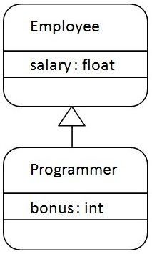
Here, Programmer is the subclass and Employee is the superclass. Relationship between two classes is Programmer IS-A Employee. It means that Programmer is a type of Employee.

Slide 6
class Employee{
float salary=40000;
}
class Programmer extends Employee{
int bonus=10000;
public static void main(String args[]){
Programmer p=new Programmer();
System.out.println("Programmer salary is:"+p.salary);
System.out.println("Bonus of Programmer is:"+p.bonus);
}
}
Output:
Programmer salary is:40000.0
Bonus of programmer is:10000

Slide 7
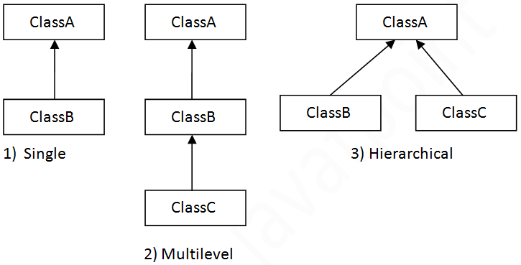
Types of inheritance in java
On the basis of class, there can be three types of inheritance in java: single
multilevel and
hierarchical.
Note: Multiple inheritance is not supported in java

Slide 8
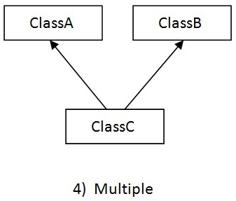
When a class extends multiple classes i.e. known as multiple inheritance. For Example:
Note: Multiple inheritance is not supported in java

Slide 9
Single Inheritance
class Animal{
void eat(){System.out.println("eating...");}
}
class Dog extends Animal{
void bark(){System.out.println("barking...");}
}
class TestInheritance{
public static void main(String args[]){
Dog d=new Dog();
d.bark();
d.eat();
}}
Output:
barking...
eating...

Slide 10
Multilevel Inheritance
class Animal{
void eat(){System.out.println("eating...");}
}
class Dog extends Animal{
void bark(){System.out.println("barking...");}
}
class BabyDog extends Dog{
void weep(){System.out.println("weeping...");}
}
class TestInheritance2{
public static void main(String args[]){
BabyDog d=new BabyDog();
d.weep();
d.bark();
d.eat();
}}
Output:
weeping...
barking...
eating..

Slide 11
Hierarchical Inheritance
class Animal{
void eat(){System.out.println("eating...");}
}
class Dog extends Animal{
void bark(){System.out.println("barking...");}
}
class Cat extends Animal{
void meow(){System.out.println("meowing...");}
}
class TestInheritance3{
public static void main(String args[]){
Cat c=new Cat();
c.meow();
c.eat();
//c.bark();//C.T.Error
}}
Output:
meowing...
eating...

Slide 12
Why multiple inheritance is not supported in java?
class A{
void msg(){System.out.println("Hello");}
}
class B{
void msg(){System.out.println("Welcome");}
}
class C extends A,B{//suppose if it were
Public Static void main(String args[]){
C obj=new C();
obj.msg();//Now which msg() method would be invoked?
}
}
To reduce the complexity and simplify the language, multiple inheritance is not supported in java.
Consider a scenario where A, B and C are three classes. The C class inherits A and B classes. If A and B classes have same method and you call it from child class object, there will be ambiguity to call method of A or B class.
Since compile time errors are better than runtime errors, java renders compile time error if you inherit 2 classes. So whether you have same method or different, there will be compile time error now.
Output:
Compile Time Error

Slide 13
Method Overriding in Java
If subclass (child class) has the same method as declared in the parent class, it is known as method overriding in java.
In other words, If subclass provides the specific implementation of the method that has been provided by one of its parent class, it is known as method overriding.

Slide 14
Usage of Java Method Overriding
Method overriding is used to provide specific implementation of a method that is already provided by its super class.
Method overriding is used for runtime polymorphism

Slide 15
Rules for Java Method Overriding
method must have same name as in the parent class
method must have same parameter as in the parent class.
must be IS-A relationship (inheritance).

Slide 16
Example of method overriding
we have defined the run method in the subclass as defined in the parent class but it has some specific implementation. The name and parameter of the method is same and there is IS-A relationship between the classes, so there is method overriding.
class Vehicle{
void run(){System.out.println("Vehicle is running");}
}
class Bike2 extends Vehicle{
void run(){System.out.println("Bike is running safely");}
public static void main(String args[]){
Bike2 obj = new Bike2();
obj.run();
}
Output:
Bike is running safely

Slide 17
Access modifiers with method overriding
If you are overriding any method, overridden method (i.e. declared in subclass) must not be more restrictive.
The default modifier is more restrictive than protected. That is why there is compile time error
class A{
protected void msg(){System.out.println("Hello java");}
}
public class Simple extends A{
void msg(){System.out.println("Hello java");}//C.T.Error
public static void main(String args[]){
Simple obj=new Simple();
obj.msg();
}
}

Slide 18
Can we override static method?
No, static method cannot be overridden. because static method is bound with class whereas instance method is bound with object. Static belongs to class area and instance belongs to heap area.
Can we override java main method?
No, because main is a static method.

Slide 19
Difference between method overloading and method overriding in java
No. | Method Overloading | Method Overriding
1) | Method overloading is used to increase the readability of the program. | Method overriding is used to provide the specific implementation of the method that is already provided by its super class.
2) | Method overloading is performed within class. | Method overriding occurs in two classes that have IS-A (inheritance) relationship.
3) | In case of method overloading, parameter must be different. | In case of method overriding, parameter must be same.
4) | Method overloading is the example of compile time polymorphism. | Method overriding is the example of run time polymorphism.
5) | In java, method overloading can't be performed by changing return type of the method only. Return type can be same or different in method overloading. But you must have to change the parameter. | Return type must be same or covariant in method overriding.

Slide 20
Difference between method overloading and method overriding in java
Java Method Overloading example
class OverloadingExample{
static int add(int a,int b){return a+b;}
static int add(int a,int b,int c){return a+b+c;}
}
Java Method Overriding example
class Animal{
void eat(){System.out.println("eating...");}
}
class Dog extends Animal{
void eat(){System.out.println("eating bread...");}
}

Slide 21
Thank you

